Slide 1
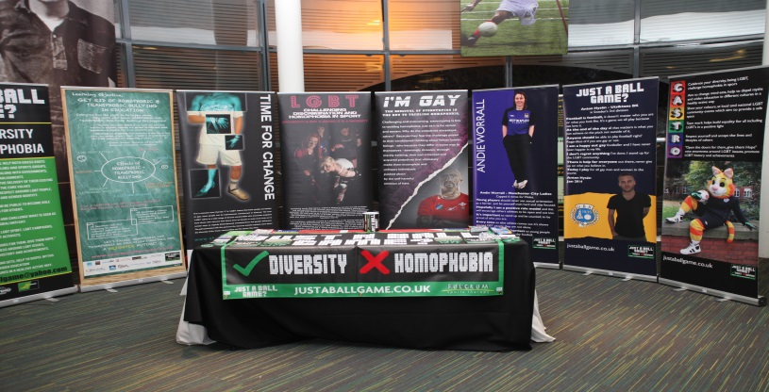
Ladies partner teams and clubs.
JUST A BALL GAME?
Notes:
JUST A BALL GAME?

Slide 2
Aims and objectives.
To encourage and promote football, sport and healthy leisure activities among lesbians, gay men, bisexuals and transgendered people (hereafter referred to as LGBT+) regardless of race, religion, sex, age, physical ability, or disability.
To help build a LGBT+ football community, linking individuals, organisations, clubs, and associations engaged in football (sport), ensuring an effective communication.
To raise awareness about equality, inclusion and diversity, combat discrimination and homophobia in football/sport, and working closely with other initiatives and organisations.
To promote LGBT+ engagement in sport and leisure activities through participation and/or volunteering in football/ sport.
To promote LGBT+ representation in mainstream football/sport and encourage LGBT+ involvement in the wider sporting community from elite to grass roots.
In pursuit of these aims our organisation will promote equal opportunities and encourage gender parity.
Notes:
JBG?: AIMS & OBJECTIVES.

Slide 3
PATRON ANDIE WORRALL
"It's something I have close to my heart, something I have thought about for a while, now, it’s a big step to take. I’m not sure if others will follow the same path, but, I hope that I can inspire young people and show that being a lesbian and playing at the top level in women’s football is not detriment to the career path you can carve out for yourself. When you think about it around three quarters of women who play the game identify as being LGBT."
Notes:
PATRON: ANDIE WORRALL.

Slide 4
Partner Teams and Clubs in the Women’s Game.
Notes:
Andie and friends play for JBG? in 2013.

Slide 5
JUST A BALL GAME? LADIES FUTSAL TEAM
Notes:
JBG? Ladies Futsal Team.

Slide 6
AFC Rushden & Diamonds Ladies
Notes:
AFC Rushden & Diamonds Ladies.

Slide 7
Birmingham City Ladies FC
Birmingham City Ladies Football Club was formed in 1968 by a group of female fans who played local friendly matches until 1970.
In March 2010 the Club was announced as a founder member of the FA WSL. The Club's successful application was underwritten by Birmingham City's owner Carson Yeung. n May 2012 the Club won their first FA Women's Cup, beating Chelsea on penalties in the final at Ashton Gate in Bristol.
Also in 2012, for the second consecutive year, the Club finished 2nd in the FA WSL and were runners-up in the Continental Cup Final, both to Arsenal. The 2nd place finish in the league qualified Birmingham for the 2013–14 UEFA Women's Champions League round of 32.
Notes:
Birmingham City Ladies FC.

Slide 8
WYTHENSHAWE AMATEURS LADIES FC
Notes:
Wythenshawe Amateurs Ladies FC.

Slide 9
Preston North End Women

Slide 10
Preston North End women
Warm up
Keeper warm up

Slide 11
BURTON ALBION LADIES FC
Notes:
Burton Albion Ladies FC

Slide 12
FC REEDSWOOD LADIES TEAM
Notes:
FC REEDSWOOD LADIES TEAM

Slide 13
Les Degommuses

Slide 14
JBG? Merseyside

Slide 15
Notes:
JUST A BALL GAME?

Slide 16
JUST A BALL GAME.CO.UK @justaballgame

